Slide 1
Content Strategy 101
Brand Content Pillars
Voice & Tone

Slide 2
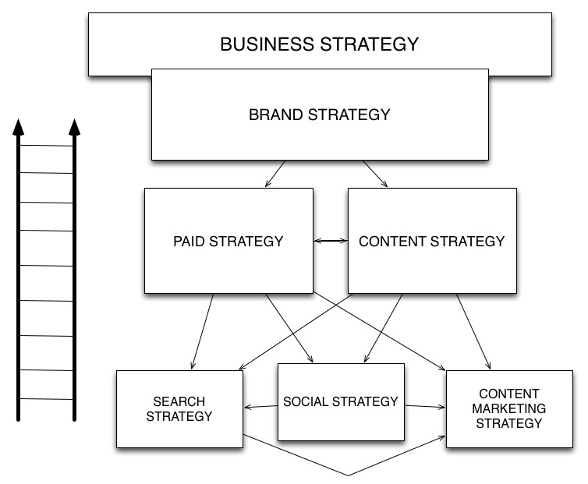
YOU ARE HERE!
Notes:
Let’s look at how Content Strategy might fit into the bigger picture of a company’s marketing and messaging
Paid vs. Owned – we’re mainly focused on the owned media here. But more and more paid and owned should work together to exemplify the brand story – a story that starts with the ad – continues to a website or a store and ends with a sale…

Slide 3
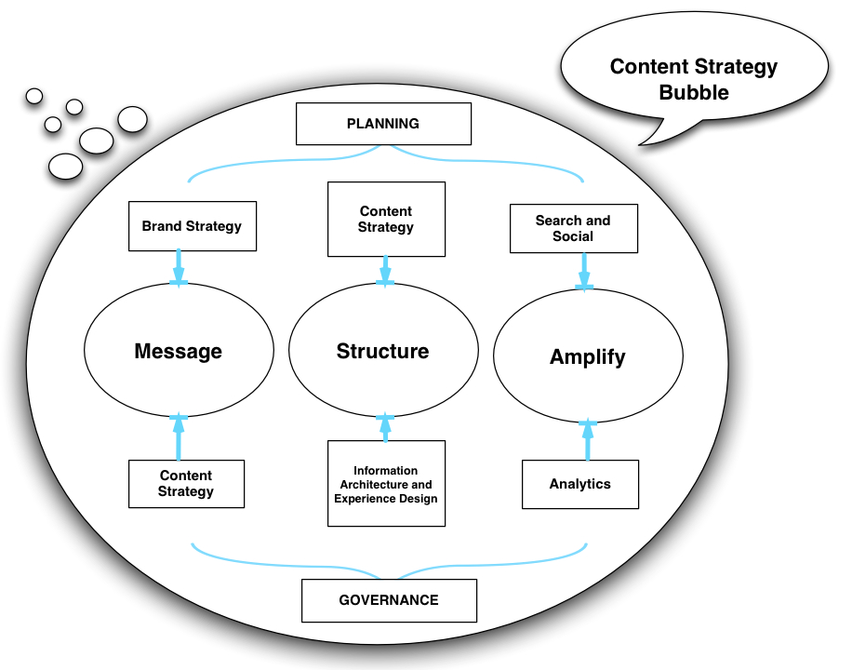
Notes:
This bubble can be applied to creating content experiences.
Content marketing, branded content, native advertising, brand storytelling, sponsored content, brand communities>>>> with the “traditional notions” of owned content – websites, blogs, microsites, and apps

Slide 4
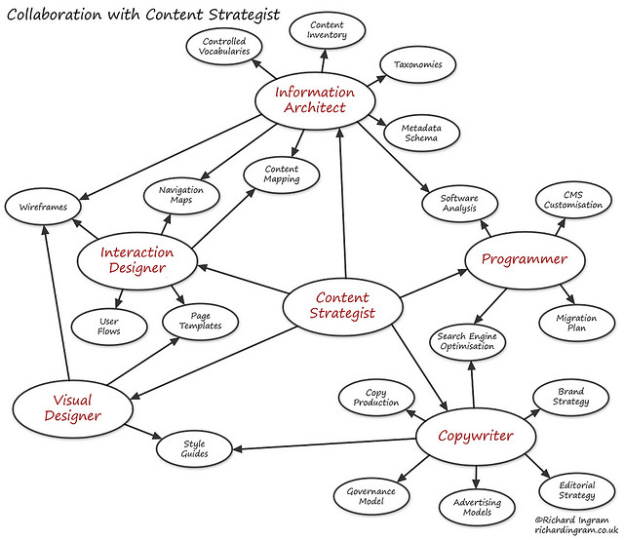
Notes:
A GOOD CS HELPS INFORM DESIGN CHOICES with an understanding of the amount of content, the types of content, and the disposition of that content – usable, findable, engaging, brand-aligned…
But long before creation and implementation a CS can help lay the strategic foundation for what will be created by working upstream with brand strategists and stakeholders to define the ground rules, guard rails, guidelines, and themes that a brand will talk about
CS informing design is mostly what we are dealing with on the day-to-day, but from a more strategic vantage point we should be considering how to translate brand meaning into content that consumers can relate to
THIS IS REALLY THE FOCUS OF TODAY’S CONVERSATION – the type of content that can do that…

Slide 5

What does a brand represent?
A brand does not sell coffee, concert tickets, books, lipstick, yogurt, entertainment or information.
Notes:
Starbucks – not a coffee shop, but a “third place”

Slide 6



What does a brand stand for?
“Medicine doesn’t sell cures, it sells trust … many brands sell a promise of a better version of ourselves. Tiffany sells mattering, Facebook sells belonging and Whole Foods sells nurturing and self-love.”
- The Story of Telling blog (http://thestoryoftelling.com/blog/)
Notes:
Brand consultant in Perth, Australia a strong advocate for storytelling over interruption marketing – for educating consumers instead of screaming the latest deal at them. (both approaches still have their place depending on the context)
Aegis, Story Worldwide, and to some extent Digitas…

Slide 7
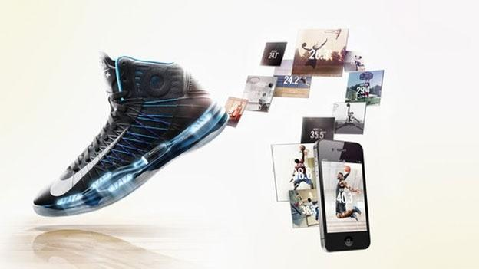
How does a brand express itself?
By telling a brand story…
Notes:
it’s just a shoe – but it’s become so much more with branding
Stories about the human spirit, transformation, climbing the mountain, reaching the top
Capturing the essence of why a company got into the business in the first place – like I said, an approach beyond just barking out 50% Off deals

Slide 8



Brand meaning and value can be expressed in lots of ways
Service (Amazon)
Price (Wal-Mart)
Durability (Dickies)
Design (Apple)
Reliability (Hyundai)
Notes:
Brand meaning and value can be expressed in lots of ways, many quantifiably more valuable than content… service, price points, location, quality of a product, design of a product, trustworthiness of a product, etc…

Slide 9
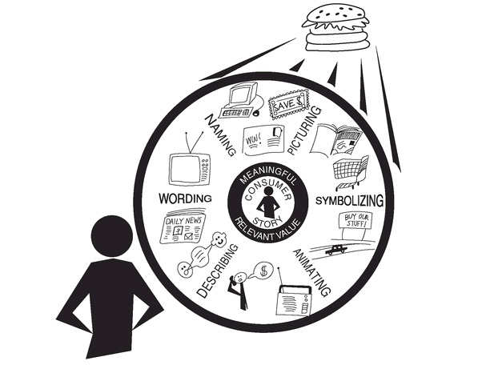
When a brand wants to tell its story it is increasingly choosing to express and convey it through content…
Notes:
When a hamburger is more than a hamburger. When a shoe is more than a shoe .. Content might be viewed as the meta-representation of the brand

Slide 10

A CS can help a business translate brand meaning into content
Notes:
“As we transition into a digital age where consumers watch just as much video online as they do TV, the rules of advertising have changed. Audiences have become savvy to traditional marketing tricks, and are no longer appeased, if they ever were, with mediocre content. In order to stand out from the crowd, brands have to reach further to make an impact.” - this is from an upcoming SXSW panel on branded content
Let’s look at a few examples of brands using content to raise brand awareness and engage current and potential customers

Slide 11
Notes:
An old Digitas favorite, American Express’s small business Open Forum was started five years and today is consider the premier website for small business content and has helped raise AMEX’s profile among small business owners where it was traditionally known as a very corporate clubby credit card…

Slide 12
Notes:
Degree presents The Adrenalist – verdict is too early on this one but the ideas is that associating extreme sports with Degree, the company hopes to associate Degree as the best deodorant product to handle even the most extreme sports…

Slide 13
Notes:
Perrier presents Societe Perrier – a content experience about nightlife culture – this site taps into Perrier’s backstory as a hip, Parisian nightlife drink in the 1970s ands it association with Andy Warhol in the early 80s
http://warhol.perrier.com/

Slide 14
Notes:
Native Advertising
+ implications of appearing in search engines – something ads generally don’t do BUZZFEED, The Atlantic, Forbes – online sites with reach that meet the customers where they are

Slide 15
Notes:
A series on Connoisseurs by Stella Artois – embodying the perception of Stella Artois as a brand for beer connoisseurs

Slide 16
Notes:
A health insurer provides content for its users on diet and nutrition as it tries to associate its brand with wellness

Slide 17
YOU ARE NOW HERE!

Slide 19
Notes:
Just how big is this trend? Most CMOs of Fortune 500 companies are increasing their Content Marketing and Branded Content budgets. Now Mashable has an award for the Best Branded Content Series… Of course, all of this can begin to feel like overkill. Too many brands producing too much content. So what’s REALLY the point of all this content across all these new channels?
BREAK POINT

Slide 20
Keep customers engaged throughout their purchase journey
Notes:
Ideally it’s to keep …
Victoria’s Secret successful Pink lineup leverages Pinterest
Channel strategy

Slide 21
With differentiated, authentic content that has a personality
Notes:
Chipotle’s famous “Back to the Start” video on YouTube. Flipped the advertising model on its head

Slide 22
That informs and, when appropriate, delights
Notes:
Ben and Jerry’s social campaign called “CaptureEuphoria” had over 17,000 photo submissions. The value of CM is greater analytical insights that often far exceed the paid model provided, though an integrated approach → paid supporting owned is the most effective

Slide 23
Get content that matters most correct first
Notes:
This is really the main focus of XD – getting the user experience right
Working out the kinks of the core experience should precede and preempt any sort of grand content intiative

Slide 24
Then fan out and speak more broadly, more boldly
Notes:
Red Bull – the poster child for content marketing … their content factory is so successfully they are even selling their content to others through their Red Bull Content Pool

Slide 25
Brand content is a conversation with your customers

Slide 26
It shows you get your audience
Notes:
Mountain Dew wanting to associate itself with skateboarding and avant-garde art in a new website green-label.com

Slide 27
From clear, concise language prompts
Notes:
Zappos is great at this

Slide 28
To experiences that are spot on
Notes:
Brand communities are a way to engage without expressly trying to sell – stop screaming to buy and start helping to educate customers with content

Slide 29
It’s the words, messages, images, videos -- the content experiences

Slide 30
That can help elevate a brand

Slide 31
Notes:
ABOVE THE REST WHEN THE TIME TO BUY IS NEAR
So how do you get there? To that place where your content exemplifies your brand and transcends your product to impart meaning that matters to the customer?
My favorite Content Strategy – no need for words except a CTA! – a little a bit of marketing – a lot of brand meaning through visual content – a nice hybrid approach
Enviro action alerts and product descriptions that often describe in elaborate detail where and how their products were made. It’s a depth of experience that creates great brand allegiance. Admittedly, not all commodity products can pull this off. Some customers just want fast, prompt service and clear purchase paths laid out for them. But for some brands, this sort of relationship building is key to create repeat customers and create differentiation in a sea of sameness

Slide 32
Uh, what about the content pillars?

Slide 33
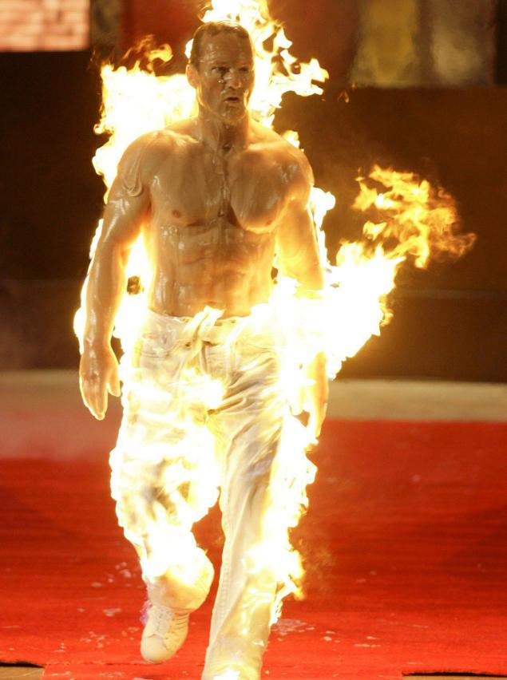
Content pillars define the major themes and motifs of the brand
Notes:
Content pillars define the major themes and motifs of the brand
The things you are going to talk about ideally embedded within your pillars some suggestions of how you are going to talk about them – Not just sports – but extreme sports – and not just extreme sports, but man’s desire to live on the edge and conquer what once seemed unconquerable

Slide 34
Content Pillars
Content pillars should intersect at the needs of the consumer, the brand, and the business.
Consumer
Business
Brand
Notes:
One way is to create content pillars

Slide 35
The pillar challenge
Notes:
The degree to which these pillars are concrete vs. abstract depends on the client and the extent to which they want to imbue meaning into the content they want to create. You can see this challenge in the differences between the blueprints samples that I provided. In the end, they should end up somewhere in the middle – actionable pillars that operate on two levels – topical and metaphorical so that they express brand meaning and are grounded enough in reality so that someone could reference them when they are tasked with creating brand content

Slide 36
Establishing pillars
Review the brand’s current content
Review the competitor’s content
Understand where the brand wants to be
Understand where the customer wants to be or what the customer wants to become
Gather the troops and ideate > think about the main meaning and the subtext of the message
Make recommendations > iterate on them
Create pillars that the stakeholders believe in and can embrace
Create pillars that creative teams can act on
Filter out content that doesn’t align (i.e., use the pillars as guardrails)
Pressure test existing content against the pillars and larger brand promise

Slide 37

Bring the pillars to life with brand voice and tone
Notes:
The Nation voice – liberal voice for political change vs. Playboy liberal voice for sexual liberation > within this context you have tone, which modulates based on the topic and what is appropriate for the circumstances

Slide 38
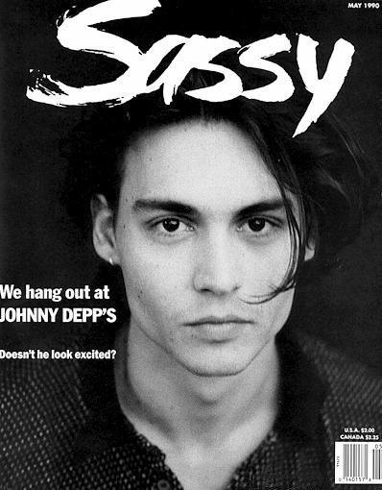

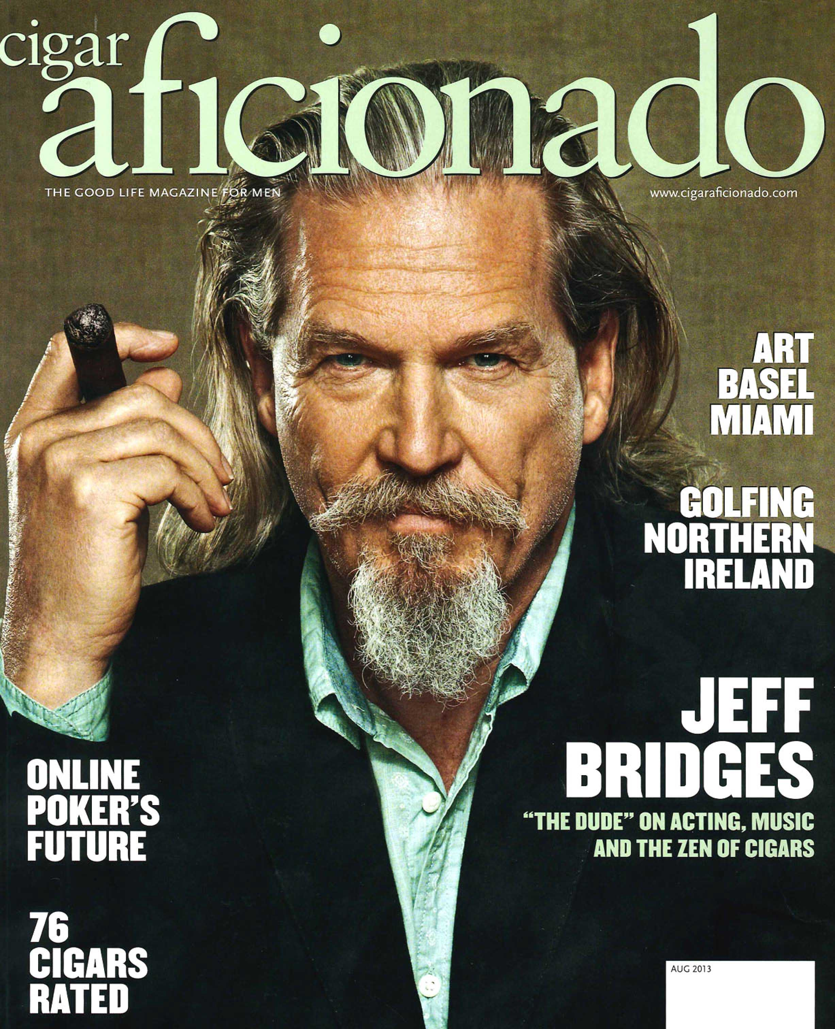
Your favorite magazine has a voice and a tone

Slide 39
Your favorite brand has a voice and a tone
Notes:
Healthy burgers are a revolutionary concept. What’s a pillar for Epic? Revolutionary Food?

Slide 40
Notes:
The Harley Davidson brand has a strong voice and tone throughout its website. (brand community)

Slide 41
Does your brand know what its content sounds like? What it feels like? What it looks like? What it smells like? What it tastes like?
Notes:
Content strategists work with experience designers, copywriters, visual designers, SEO, and others to bring all those senses to life and ultimately, hopefully, keep customers satisfied and engaged with the brand which should lead to repeat purchases and the acquisition of new customers

Slide 42
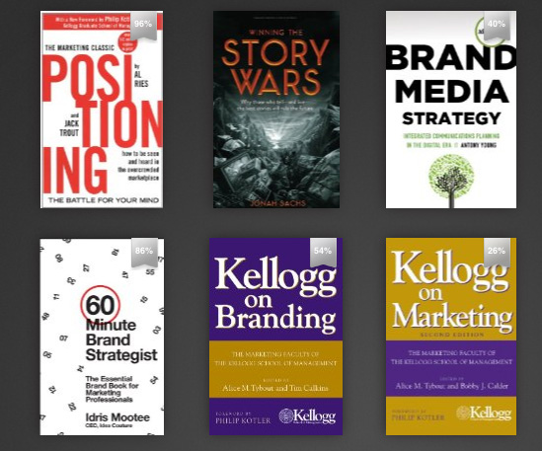
Some light reading on branding
Notes:
Positioning by Al Ries
Story Wars by Jonah Sachs
Brand Media Strategy by Anthony Young
60 Minute Brand Strategist by Idris Mootee
Kellogg on Branding
Kellogg on Marketing

Slide 43
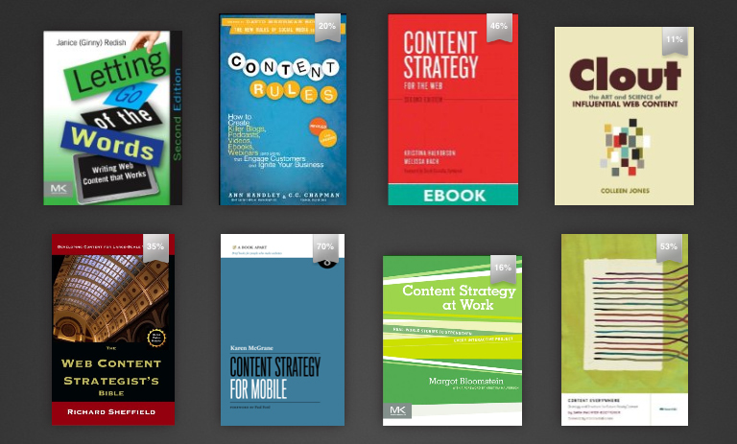
Some light reading on content strategy
Notes:
Letting Go of the Words by Ginny Redish
Content Rules by Ann Handley
Content Strategy by Kristina Halverson
Clout by Coleen Jones
The Web Content Strategist’s Bible by Richard Sheffield
Content Strategy for Mobile by Karen McGrane
Content Strategy at Work by Margot Bloomstein
Content Everywhere by Sarah Wachter-Boettcher

