Slide 1
Innovation Hub:
Content Strategy Overview
09.10.2013

Slide 2
What Is the Sprint Innovation Hub?
An engagement platform for tech geeks that demonstrates and sparks ideas about the unlimited possibilities of innovation.
Notes:
As site evolves it becomes a more interactive platform with messaging and innovation around the nation’s fastest, most powerful network.

Slide 3
Content Strategy Overview
Create mix of licensed and original content
Tap into the developer community and speak geek
Strategically position Sprint content among licensed content
Provide filtering and opportunities for nerd2nerd and Sprint 2 nerd dialogue
Leverage innovation taxonomy for personalization
Drive traffic to and from Sprint properties as appropriate
Sponsor challenges to increase site engagement
Use native ads to drive geeks to challenges
Author and license sticky “time killer” content
Notes:
1) Feature licensed innovation content created by top tech sources
2) Tap into the innovation community for inspiration, insight, and content
3) Sprint network innovation content strategically positioned among other, non-promotional articles
4) Provide faceted search functionality that allow users to filter the specific content they want to experience.
5) Is a destination spot for other Sprint content properties to drive users to.
6) Sponsors contests that leverage network speed/bandwidth to solve human problems.
7) Will generate “sponsored content” that serves as “native ads” in tech publications to “meet the geeks” where they are at.
8) Content intended as a “time killer” designed to be sticky.

Slide 4
Information Architecture

Slide 5
Information Architecture

Slide 6
Navigation Defined
Trends - The latest creations, ideas, and innovations in the world of technology that would be especially interesting to tech enthusiasts and tech geeks (mostly licensed articles and videos)
Innovators - The people behind the latest creations, ideas, and innovations in the world of technology (this is where the innovator interviews would live and innovator's aggregated feed could live)
Sprint Labs - The latest creations, ideas, and innovations brought to you by Sprint (this is where network innovation/rollout info lives like Mysto + other Sprint-created tech goodies)
Innovation Challenges - The section is where information and updates about ongoing innovation challenges would be listed + challenge videos, results, etc.

Slide 7
Innovation Taxonomy – for Trends, Innovators, & Sprint Labs navigation
Recommended Innovation Categories
Development (or Programming)
Smartphones
Network & Bandwidth
Mobile Gaming
Design
Education
Internet of Things (or Ubiquitous Computing)
Transportation
Health & Science
Environmental
Content tiles in the “Trends”, “Innovators”, and “Sprint Labs” navigation may be tagged with one or multiple categories listed above
Tagging by Author and Source (and other desired keywords) can be added for filtering at article level

Slide 8
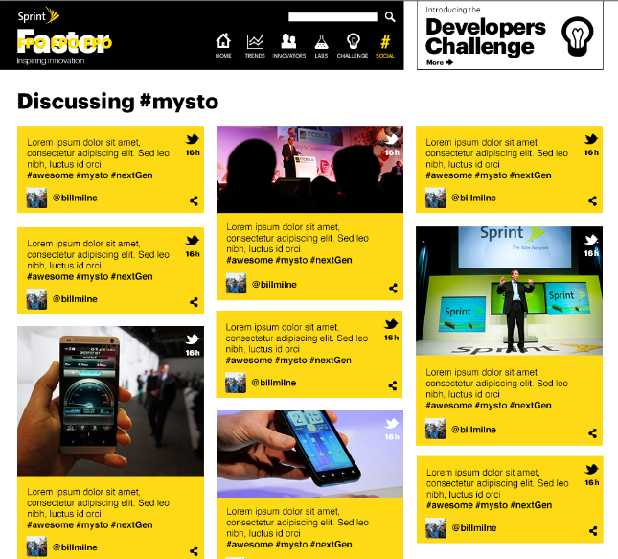
Visualizing for Value
Innovators have Twitter and Tweet Deck. What can Sprint deliver that’s differentiated and valuable?
In the know?
See what the most innovative tech minds are talking about right now:
Less noise. More value.
Give users control to explore the top conversations as they surface in real time.
#E3
#Innovation
#TwitterIPO
#Mysto
Tech thought leaders inspire discussion around the hottest trends in innovation and tech.

Slide 9
Content Cards

Slide 10

Content Cards - dynamic, programmable content objects
1) article, 2) video, 3) image, 4) API content
CONTENT TYPE
PRIORITY
REGION
TIMESTAMP
CATEGORY
SHARE

Slide 11
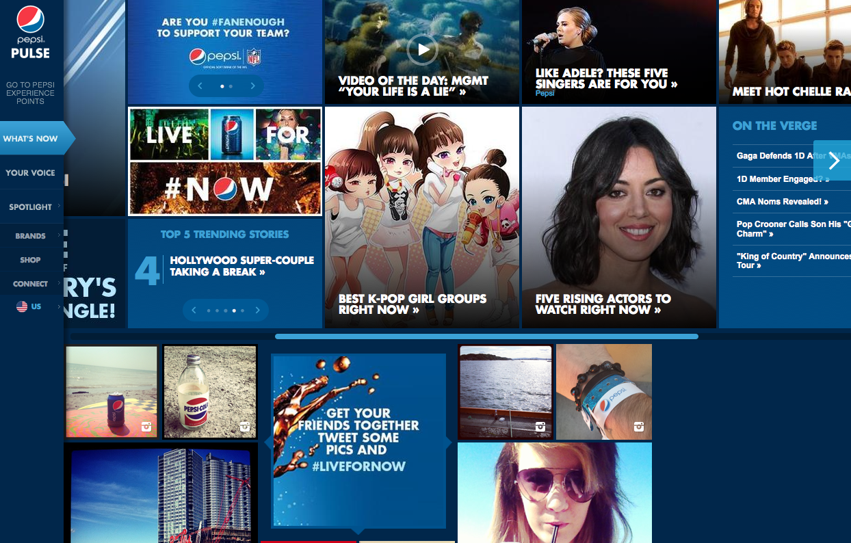
2
1
4
3

Slide 12
Content Cards – 1.0 Article Type (Home and Landing Page Attributes)
HEADLINE
SUBHEAD (optional)
IMAGE (optional)
There are three available article tiles available:
Article headline/optional sub w/ Image
Article headline w/ smaller image
Article headline no image
NOTE: First article type can be re-positioned as full takeover tile

Slide 13
Content Cards – 1.0 Article Type (Detail Page Attributes)
HEADLINE
SUBHEAD
BYLINE/ IMAGE
BODY
IMAGE(S)
METADATA

Slide 14
Content Cards – 2.0 Video Type (Home and Landing Page Attributes)
POSTER FRAME
HEADLINE
ANNOTATION
CATEGORY
METADATA
There are two available video tiles available:
Large video poster frame w/ headline
Small video poster frame no headline
NOTE: First video type can be re-positioned as full takeover tile

Slide 15
Content Cards – 2.0 Video Type (Detail Page Attributes)
POSTER FRAME
HEADLINE
ABSTRACT
TRANSCRIPT
CATEGORY
METADATA

Slide 16
Content Cards – 3.0 Image Type (Home and Landing Page Attributes)
HEADLINE
DESCRIPTION
LOCATION
CATEGORY
METADATA
There are two available image tiles available:
Large image w/ headline (info-graphic)
Small image no headline
NOTE: First image type can be re-positioned as full takeover tile

Slide 17
Content Cards – 3.0 Image Type (Detail Page Attributes)
HEADLINE
DESCRIPTION
LOCATION
CATEGORY
METADATA

Slide 18
Content Cards – 4.0 API Content (Twitter, Flickr, Instagram, Slideshare – Home and Landing Page Attributes)
AGGREGATED FEEDS
IMAGE FEEDS

Slide 19
Content Cards – 4.0 API Content (Twitter, Flickr, Instagram, Slideshare, Visual.ly – Detail Page Attributes)
AGGREGATED FEEDS
IMAGE FEEDS

Slide 20
Social Share Buttons* – Share Content
EMAIL
TWITTER
FACEBOOK
GOOGLE+
LINKED IN
*Social share button can be found on Home and Landing tiles and at the top and bottom of Details pages.
+ MY INNOVATION is tabled for a later date

Slide 21
Content Sourcing Plan

Slide 22

















Potential Partners and Cadence
INTELLIGENCE & CURATION
(daily)
Finding content that MATTERS to the audience
CREATION
(weekly)
Original, ownable assets
LICENSING
(daily)
Turn-key solution to have best in class content available on regular basis
DISTRIBUTION
(weekly)
Achieving Scale

Slide 23
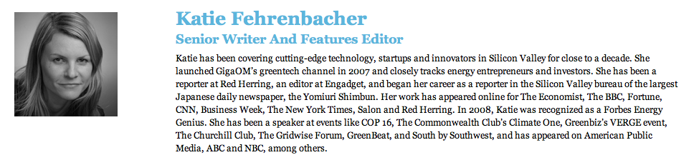
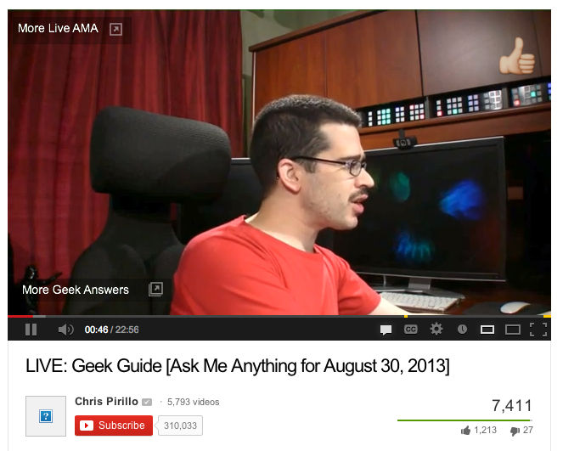
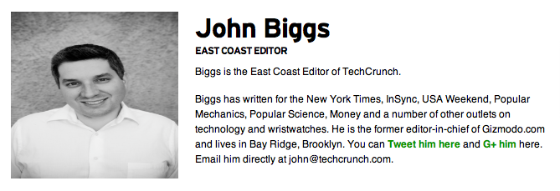

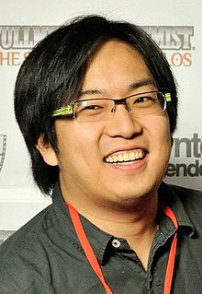
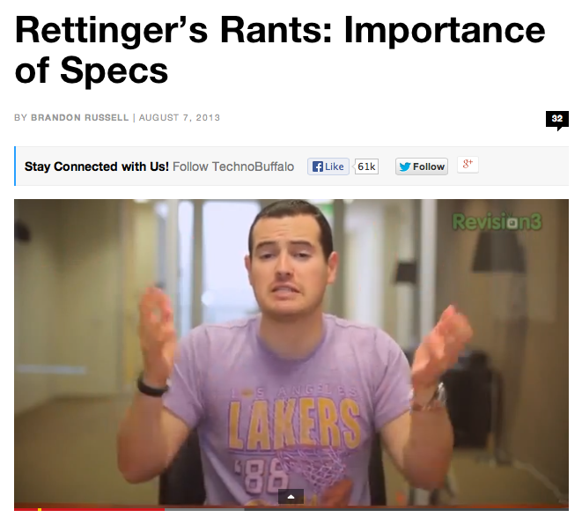
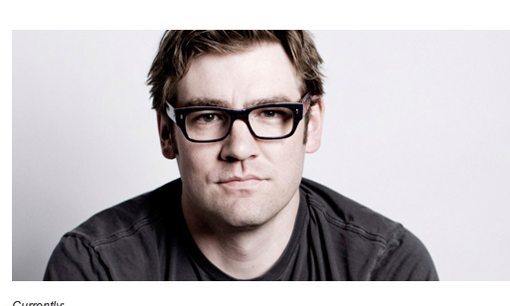

Writer/Editor on GigaOm Staff
Writer/Editor on TechCrunch Staff
Chris Pirillo of LockerGnome
Freddie Wong, YT Creator
Jamie Hyneman and Adam Savage: Tested.com & Mythbusters
John Rettinger of TechnoBuffalo
Chris Dixon: Investor, Curator of Influential tech stories

Slide 24
UX Inspiration

Slide 26
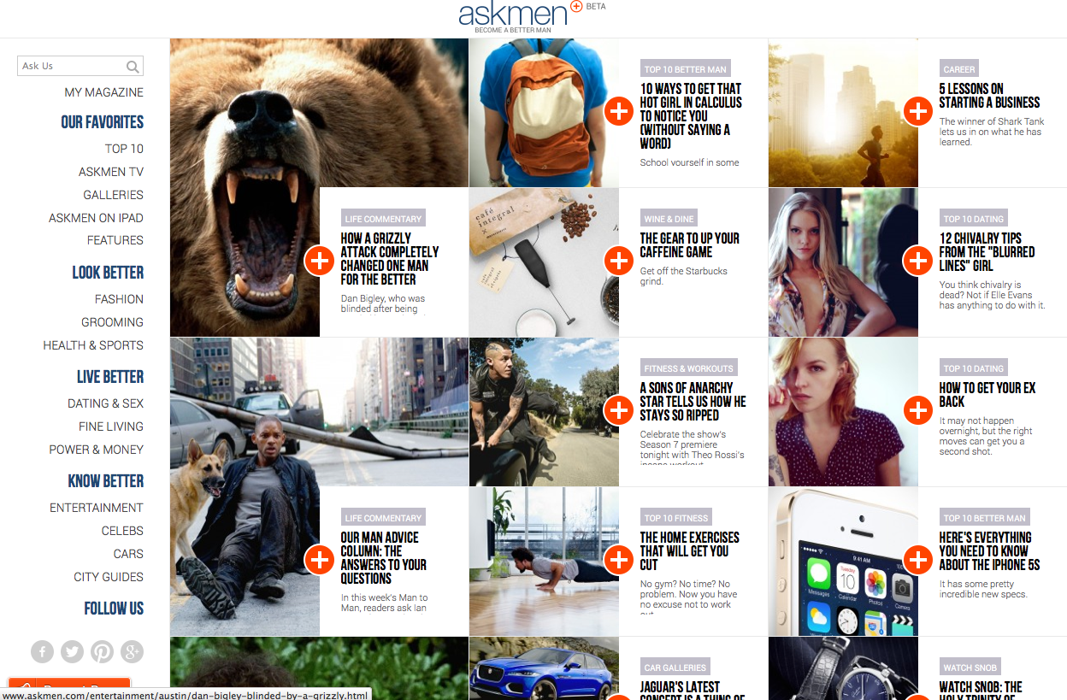

Slide 27
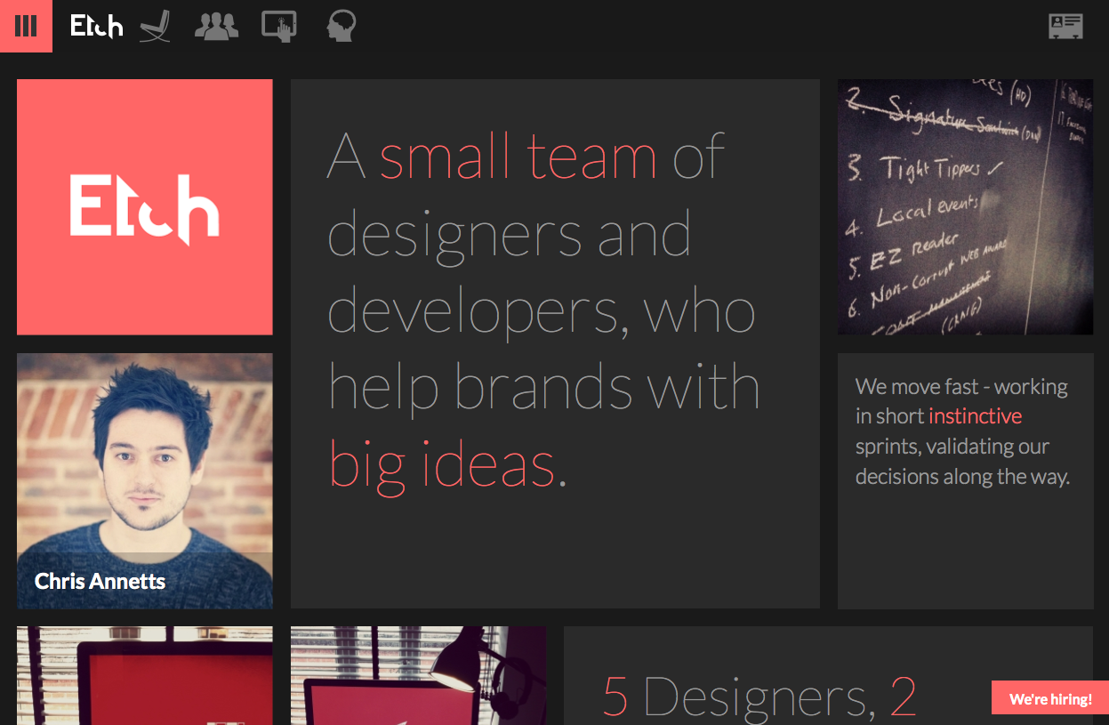

Slide 28
